Slide 1
More Formatting the Output
004_Python

Slide 2
“Old Style” String Formatting (% Operator)
Strings in Python have a unique built-in operation that can be accessed with the “%” (percentage sign) operator.
This lets you do simple positional formatting very easily.
(If you’ve ever worked with a print f-style function in C, you’ll recognize how this works instantly).
The “%” (percentage sign) operator is used to format a set of variables enclosed in a “tuple” (a fixed size list), together with a format string, which contains normal text together with "argument specifiers", special symbols like “%s” (percentage S) and “%d” (percentage D) .

Slide 3
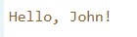
“Old Style” String Formatting (% Operator)
Let's say you have a variable called "name" with your name in it,
and you would then like to print out a greeting to that user.
# This prints out "Hello, John!"
name ="John"
print("Hello, %s!" % name)
I’m using the %s format specifier here, to tell Python where to place the string; “name”.
There are other format specifiers available that let you control the output format.
Other the “%s” for stings, we have “%d” for decimal integers (Not floating point)

Slide 4
Using two or more arguments
To use two or more argument specifiers, use a tuple (parentheses):
# This prints out "John is 23 yesrs old"
name = "John"
age = 23
print("%s is %d years old." % (name, age))

Slide 5
Type
Escape | Description | Example
%d | Decimal integers (not floating point) | “%d” % 45==45
%i | Same as %d | “%i” % 45==45
%o | Octal number | “%o” %10 ==12
%X or %x | Hexadecimal | “%x” %10 == a
%e or %E | Exponential notation | “%e” %100 ==1.000000e+01
%f or %F | Floating point real number | “%f” % 10.10==10.100000
%c | Character format | “%c” %65 =‘A’
%s | String format | “%s there” %’Hi’ == “Hi there”

Slide 6
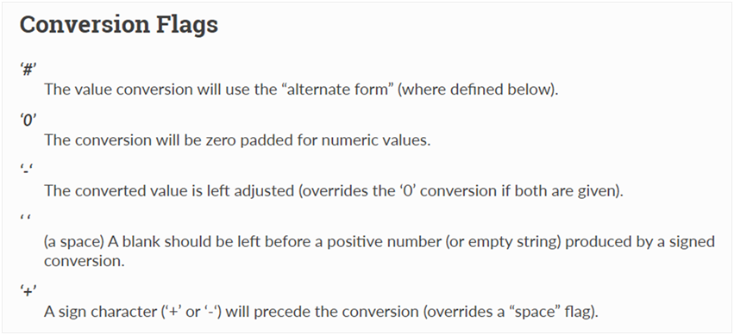
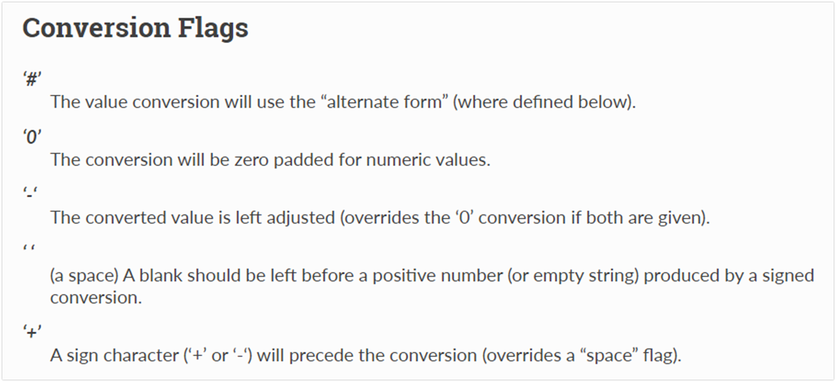
% (String Formatting(modulo) Operator)
Formats the string according to the specified format.
The general syntax for a format placeholder is
%[flags][width][.precision]type

Slide 7
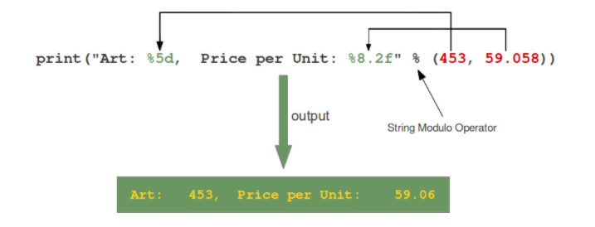
% (String Formatting(modulo) Operator)
The following diagram depicts how the string modulo operator works:
The format string contains placeholders. There are two of those in our example: "%5d" and "%8.2f".

Slide 8
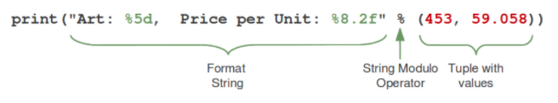
%(String Formatting(modulo)Operator)
On the left side of the "string modulo operator" there is the so-called “format string”
On the right side is a “tuple” with the content, which is interpolated in the format string.
The values can be literals, variables or arbitrary arithmetic expressions.
Notes:
Let's have a look at the placeholders in our example. The second one "%8.2f" is a format description for a float number. Like other placeholders, it is introduced with the "%" character. This is followed by the total number of digits the string should contain. This number includes the decimal point and all the digits, i.e. before and after the decimal point. Our float number 59.058 has to be formatted with 8 characters. The decimal part of the number or the precision is set to 2, i.e. the number following the "." in our placeholder. Finally, the last character "f" of our placeholder stands for "float".
If you look at the output, you will notice that the 3 decimal digits have been rounded. Furthermore, the number has been preceded in the output with 3 leading blanks.
The first placeholder "%5d" is used for the first component of our tuple, i.e. the integer 453. The number will be printed with 5 characters. As 453 consists only of 3 digits, the output is padded with 2 leading blanks

Slide 9
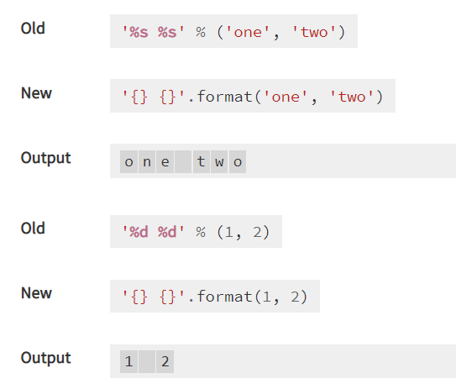
Basic formatting
Simple positional formatting is probably the most common use-case. Use it if the order of your arguments is not likely to change and you only have very few elements you want to concatenate.
Since the elements are not represented by something as descriptive as a name this simple style should only be used to format a relatively small number of elements.
Notes:
Print(“{} {} {} {} {}”.format(1,2,3,4,5))

Slide 10
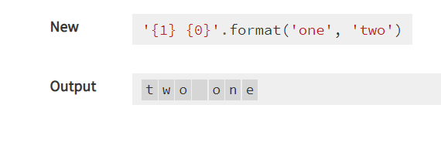
Index formatting
Index formatting is not possible in the old-style formatting

Slide 11
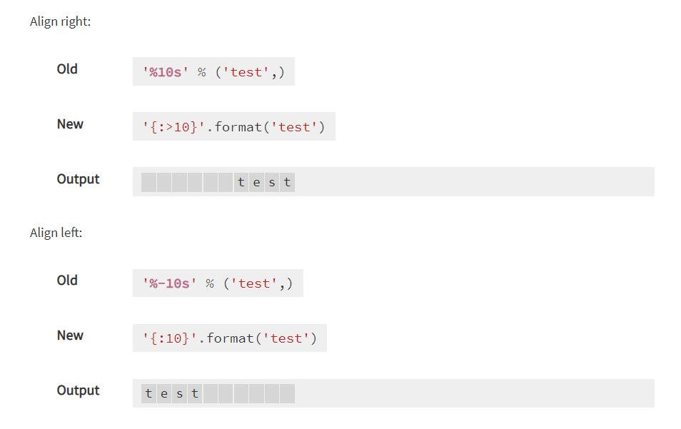
Padding and aligning strings
By default, values are formatted to take up only as many characters as needed to represent the content.
It is however also possible to define that a value should be padded to a specific length.
Unfortunately, the default alignment differs between old and new style formatting.
The old-style defaults to right aligned while for new style it's left.

Slide 12
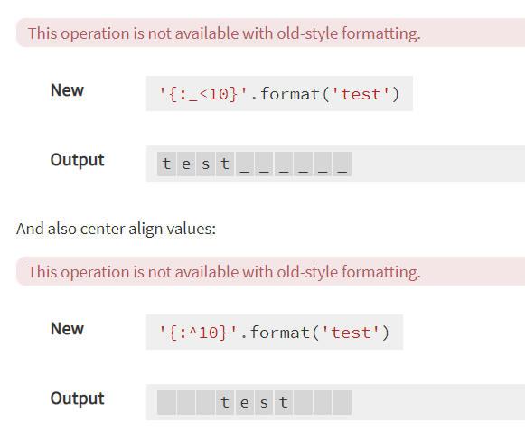
Padding and aligning Strings
Again, new style formatting surpasses the old variant by providing more control over how values are padded and aligned.
You can choose the padding character:

Slide 13
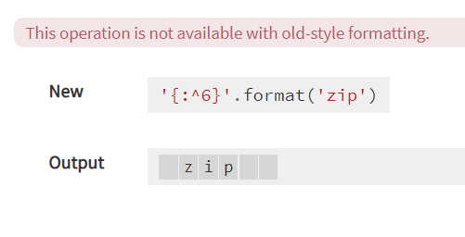
Padding and aligning Strings
When using centre alignment where the length of the string leads to an uneven split of the padding characters the extra character will be placed on the right side:

Slide 14
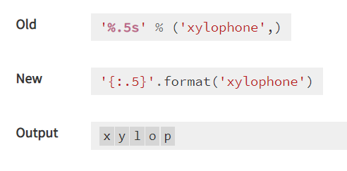
Truncating long strings
Inverse to padding, it is also possible to truncate overly long values to a specific number of characters.
The number behind a ‘ . ’ in the format specifies the precision of the output.
For strings that means that the output is truncated to the specified length.
In our example this would be 5 characters.

Slide 15
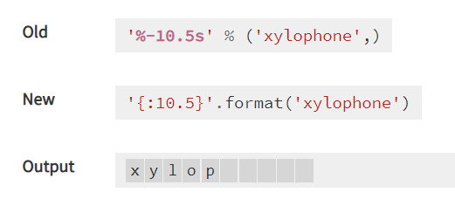
Combining truncating and padding
It is also possible to combine truncating and padding:

Slide 16
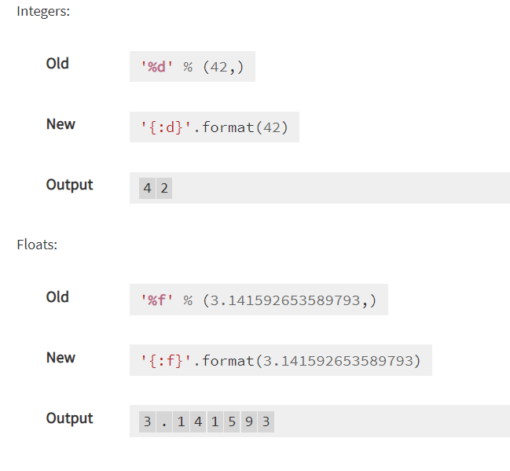
Formatting Numbers
It is also possible to format numbers.

Slide 17
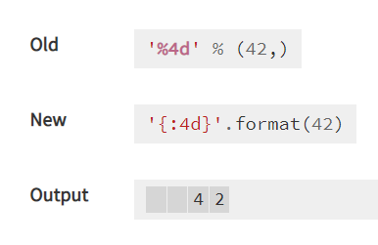
Specifying Width for numbers
Similar to strings numbers can also be set to a specific width.

Slide 18
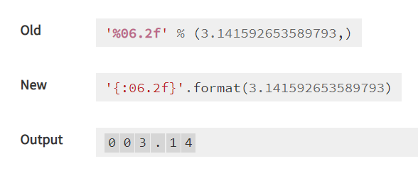
Specifying precision
Again, like truncating strings the precision for floating point numbers limits the number of positions after the decimal point. For a floating point, the padding value represents the length of the complete output.
In the example on the right, we want our output to have at least 6 characters with 2 after the decimal point.
Notes:
print("Employee Age:%0-10d"%(emp_age)) # no –effect (only left alignment, no padding wit zeros on the right side)
print("Employee Age:%010d"%(emp_age))
o/p:
Employee Age:27
Employee Age:0000000027

Slide 19
Specifying precision for Integers
For integer values providing a precision, doesn't make much sense and is actually forbidden in the new style (it will result in a ValueError)

Slide 20
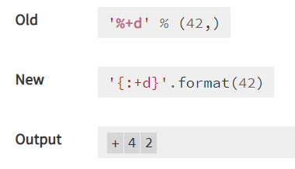
Signed numbers
By default, only negative numbers are prefixed with a sign. This can be changed of course.

Slide 21
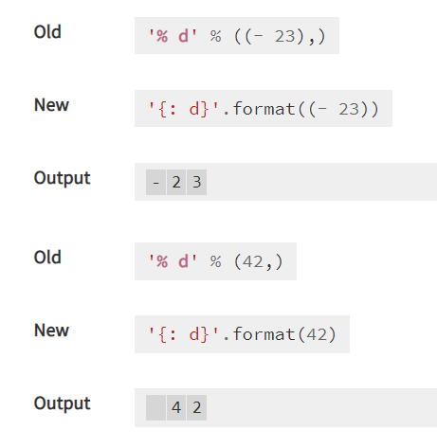
Signed numbers
Use a “- ” minus character to indicate that negative numbers should be prefixed with a minus symbol
and a leading space should be used for positive ones.

Slide 22
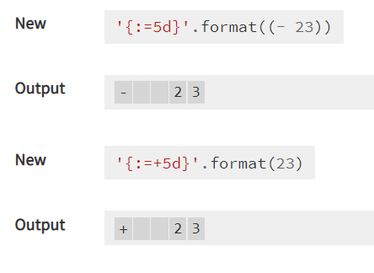
Signed numbers
New style formatting is also able to control the position of the sign symbol relative to the padding.
This operation is not available with old-style formatting.

Slide 23
Which Style to choose?
In Python 3, the “new style” string formatting is to be preferred over % - style formatting.
While “old style” formatting has been de-emphasized, it has not been deprecated. It is still supported in the latest versions of Python.

Slide 24

Operators

Slide 25
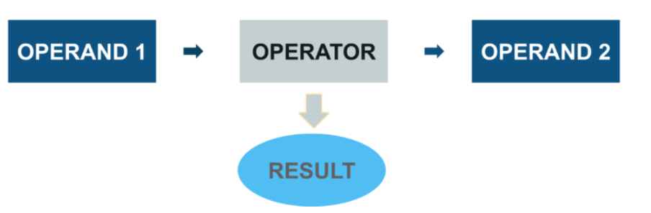
What is an Operator?
An operator is a symbol that performs an operation on one or more operands.
An operand is a variable or a value on which we perform the operation.

Slide 26
Operator
Python Operator falls into 7 categories:
Operator |  | Operator
Arithmetic Operator | (+,-,*,/, …) | Membership Operator | (in, not in)
Relational Operator | (<,>,==, …) | Identity Operator | (is, is not)
Assignment Operator | ( =, +=, … ) | Bitwise Operator | (&, |,~, ^)
Logical Operator | (and, or ,not, …)

Slide 27
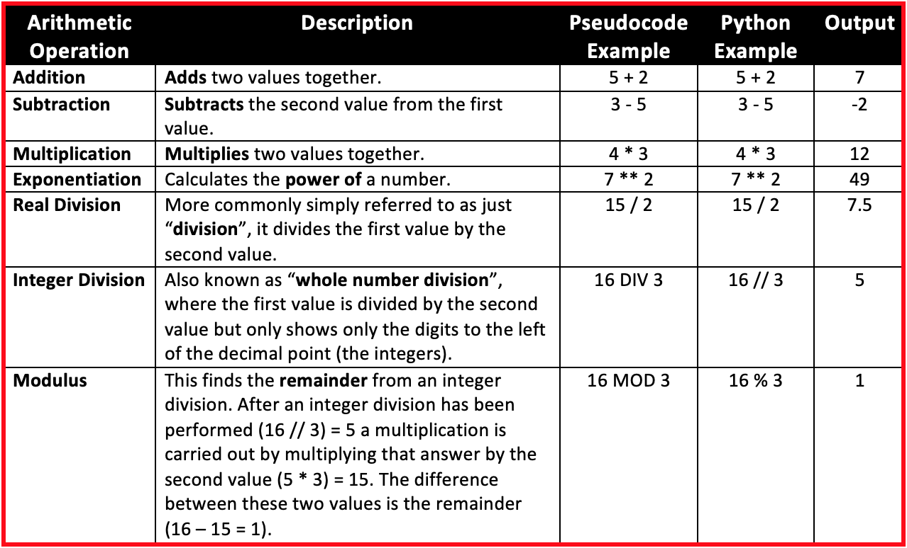
Arithmetic operators
Arithmetic operators are used to perform mathematical operations like addition, subtraction, multiplication, etc.
Note:
/ operator always performs floating point arithmetic. Hence it will always returns float value.
But Floor division (//) can perform both floating point and integral arithmetic. If arguments are int type then result is int type. If at least one argument is float type then result is float type.

Slide 28
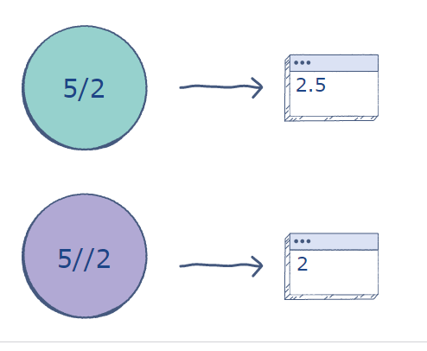
Types of division operators
In Python, there are two types of division operators:
“ / ” Divides the number on its left by the number on its right and returns a floating point value.
“//” Divides the number on its left by the number on its right, rounds down the answer, and returns a whole number. But even if one of the operand is a float, then the result is float.

Slide 29
Example - Division
print(4/2)
print(4//2)
print(11/2)
print(11//2)
“ / ” Always returns float value
With floor divide a // b:
If a is divisible by b the result is the integer value of (a / b)
If a is not divisible by b the result is the integer value below (a / b)

Slide 30
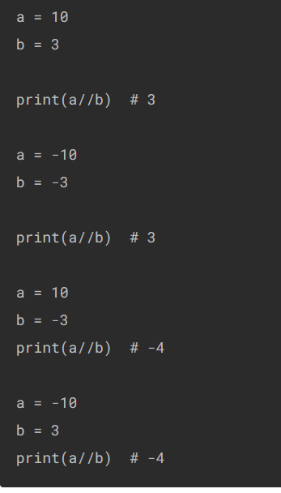
Example – Floor Division
The example on the left uses the floor division operators with positive ,
negative integers and float values
print(10//3)
#3
print(10.0//3)
#3.0
print(10.3//3)
#3.0

Slide 31
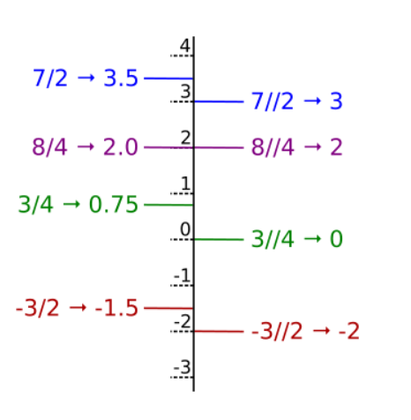
Example

Slide 32
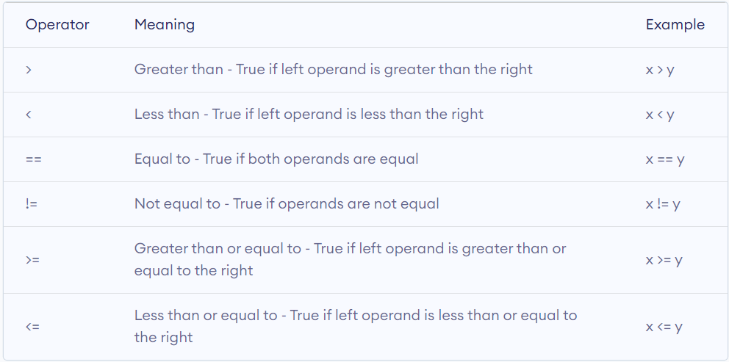
Comparison/Relational operators
Comparison operators are used to compare values.
It returns either True or False according to the condition.

Slide 33
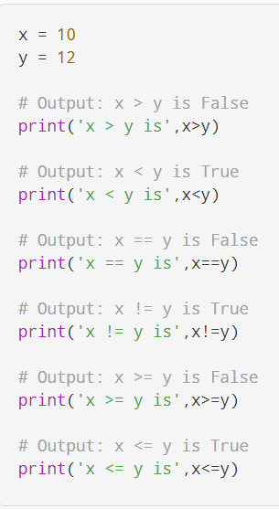
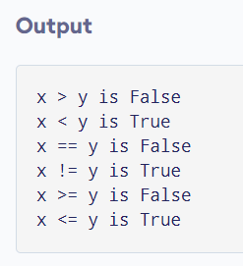
Comparison operators - Example

Slide 34
Comparing strings
Comparison operators can be used not just on numbers, you can also compare strings.
print('Savan' > 'savan’)
The above snippet will return us False.
Its because the ASCII value of “s” is 115 and ASCII value of “S” is 83.
When you compare strings, the ASCII values of the first characters are first compared. If the ASCII values are different, a boolean result is returned based on the comparison. If the ASCII values are same, the next characters are compared and so on.

Slide 35
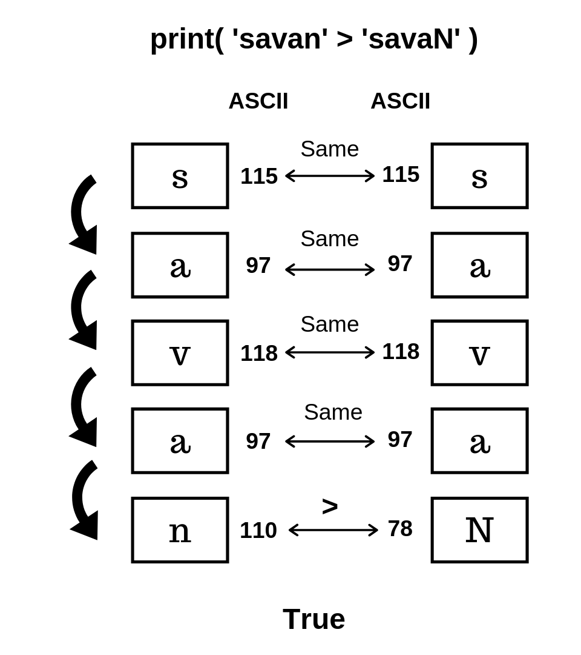
Comparing strings
what happens when you run the following code?
print('savan' > 'savaN’)
The starting 4 characters of both the strings are same. Only the last character is different. In this case, python will compare the ASCII values of all the characters until the last. Since the ASCII value of n(110) is greater than the ASCII value of N(78), Python will return us True. The image on the side shows the pictorial representation of the process.
Notes:
print(ord('a'))
print(ord('A'))
print(ord('*’))
Output:
97
65
42

Slide 36
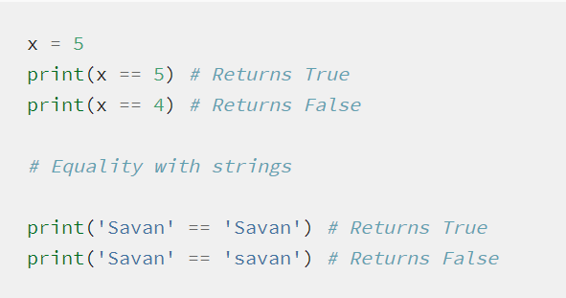
Equality operator (==)
Equality operator is used to check the equality of the values of its operands.
Not to be confused with the equal to (=) operator.
The = operator is used to assign a value to a variable. When you say x = 5, you are assigning the value 5 to variable x.
The == operator just checks if the values of both left and right operands are equal or not, and returns a Boolean value.

Slide 37
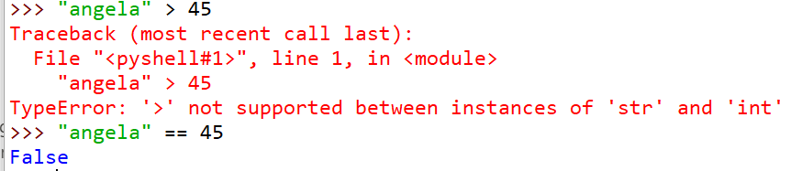
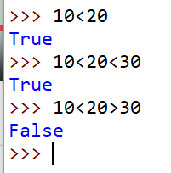
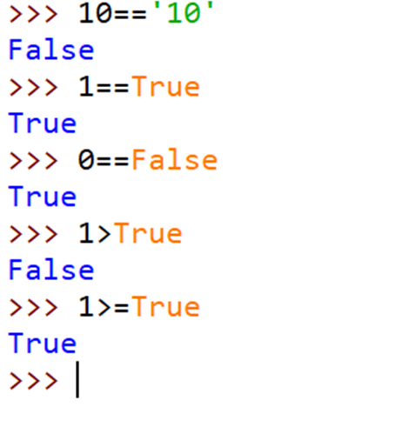
Comparison Operators - Example

Slide 38
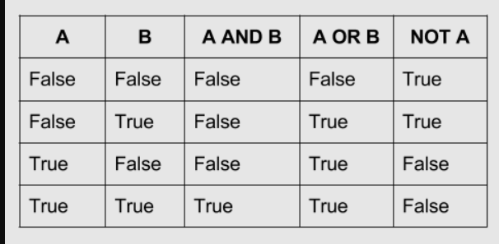
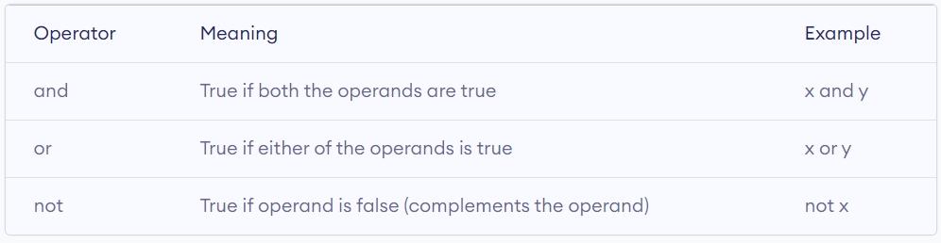
Logical operators
Logical operators are the and, or, not operators.

Slide 39
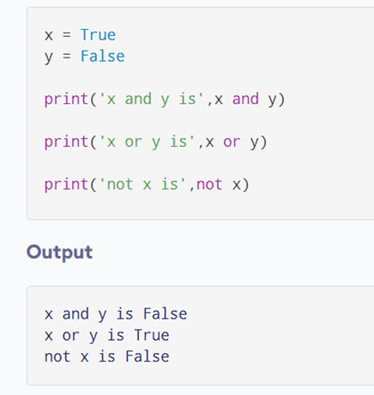
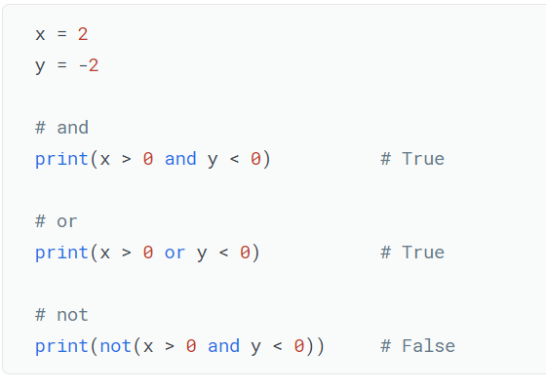
Examples

Slide 40
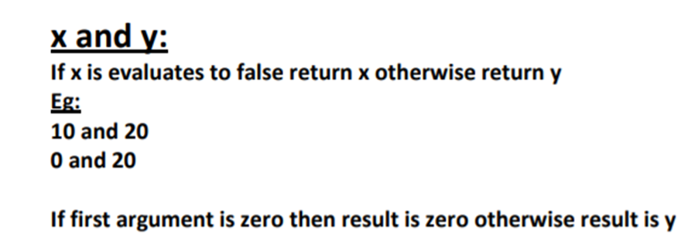
Logical operators for Non-Boolean types
0 means False
Non-zero means True
Empty string is always treated as False
20
0

Slide 41
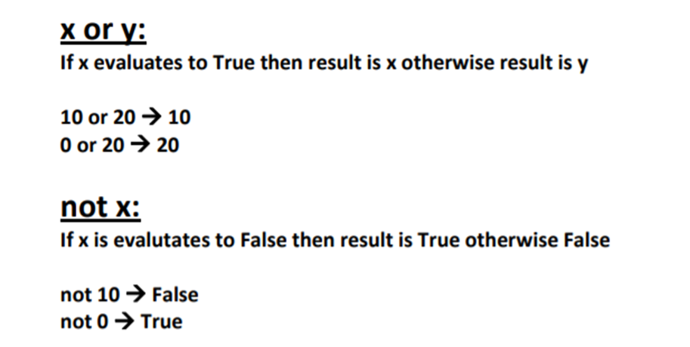
Logical operators for Non-Boolean types

Slide 42
Bitwise operators
Bitwise operators act on operands as if they were strings of binary digits. They operate bit by bit, hence the name.
They are applicable for int and bool type.
For example, 2 is 10 in binary and 7 is 111.

Slide 43
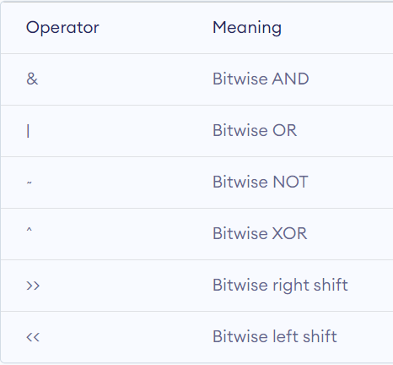
Bitwise Operators
There are 6 bitwise operators in Python. The below table provides short details about them.

Slide 44
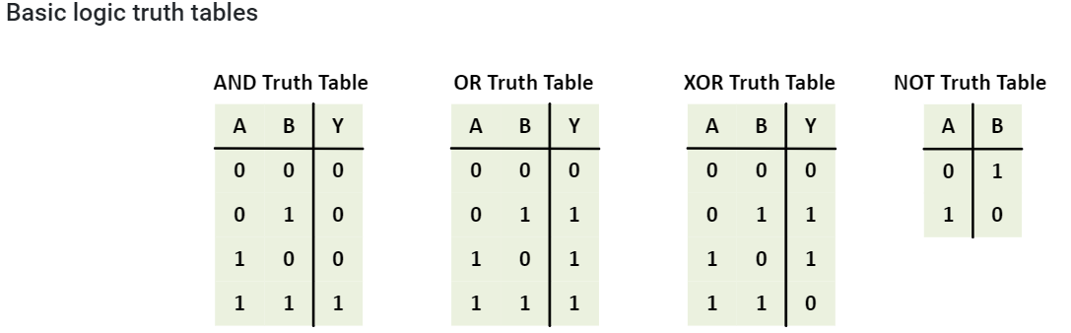
Basic logic Truth Tables

Slide 45
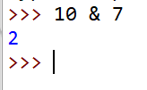
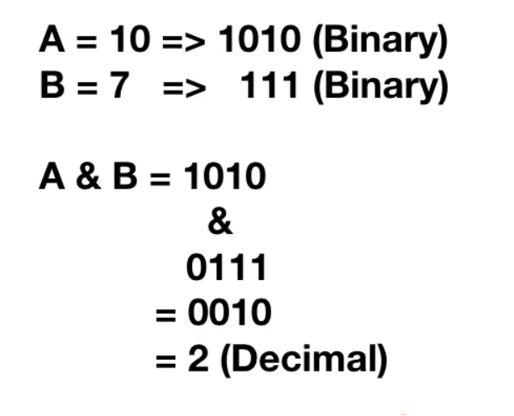
1. Bitwise AND Operator
Python bitwise and operator returns 1 if both the bits are 1, otherwise 0.

Slide 46
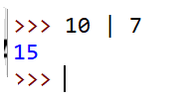
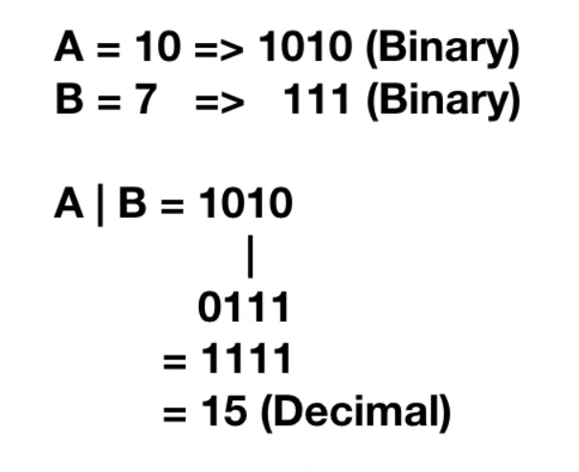
2. Bitwise OR Operator
Python bitwise or operator returns 1 if any of the bits is 1. If both the bits are 0, then it returns 0.

Slide 47
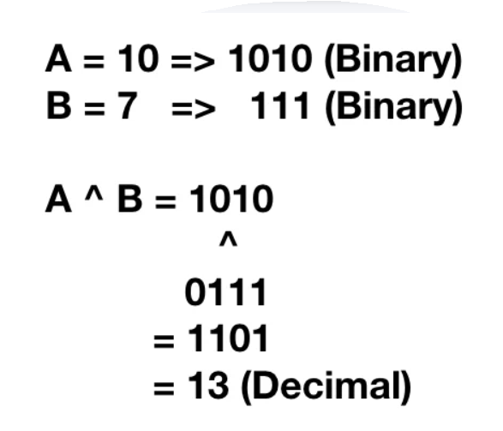
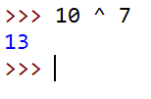
3. Bitwise XOR Operator
Python bitwise XOR operator returns 1 if one of the bits is 0 and the other bit is 1. If both the bits are 0 or 1, then it returns 0.

Slide 48
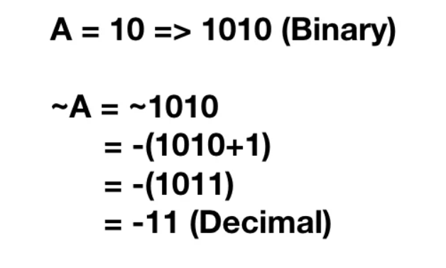
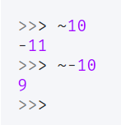
4. Bitwise Complement Operator
Python Ones’ complement of a number ‘A’ is equal to
-(A+1)

Slide 49
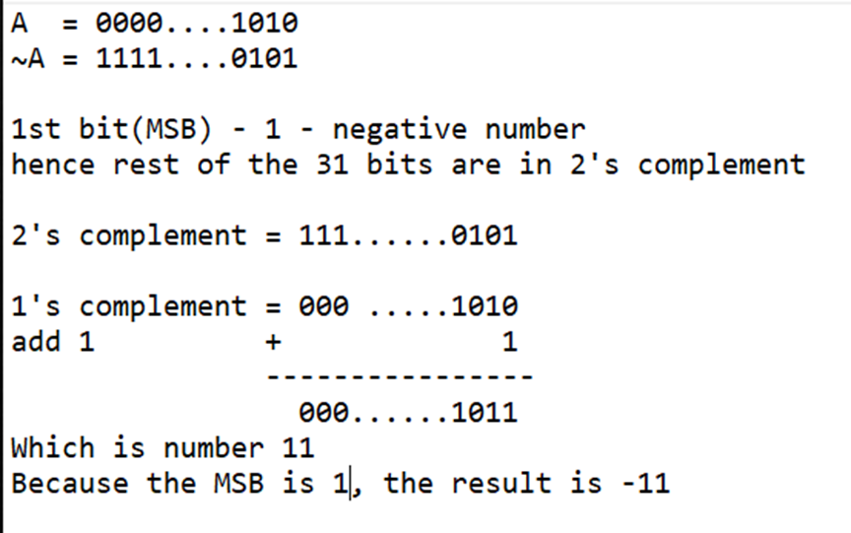
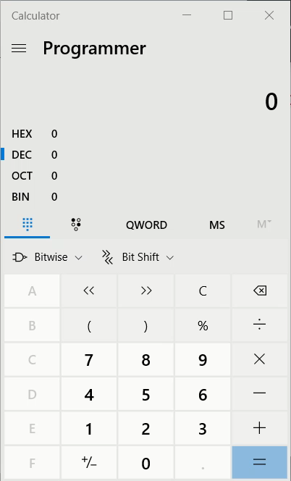
Bitwise complement Operator

Slide 50
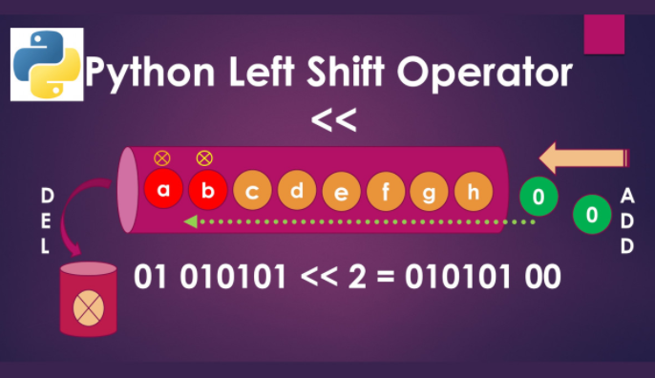


5. Bitwise Left Shift Operator
Python bitwise left shift operator shifts the left operand bits towards the left side for the given number of times in the right operand.
In simple terms, the binary number is appended with 0s at the end.

Slide 51


Slide 52



6. Bitwise Right Shift Operator
Python right shift operator is exactly the opposite of the left shift operator.
Then left side operand bits are moved towards the right side for the given number of times. In simple terms, the right-side bits are removed.
After shifting the empty cells we have to fill with sign bit.( 0 for +ve and 1 for –ve)

Slide 53




Slide 54

Using bitwise operators for Boolean types
We can apply bitwise operators for boolean types also

Slide 55
Assignment operators
Assignment operators are used in Python to assign values to variables.
a = 5 is a simple assignment operator that assigns the value 5 on the right to the variable a on the left.
There are various compound operators in Python like a += 5 that adds to the variable and later assigns the same. It is equivalent to
a = a + 5

Slide 56


Slide 57
Special operators
Python language offers some special types of operators like the identity operator or the membership operator. They are described below with examples.
Identity operators
is and is not are the identity operators in Python. They are used to check if two values (or variables) are located on the same part of the memory. Two variables that are equal does not imply that they are identical.

Slide 58

Identity Operators

Slide 59

Identity Operators
Here, we see that x1 and y1 are integers of the same values, so they are equal as well as identical. Same is the case with x2 and y2 (strings).
But x3 and y3 are lists. They are equal but not identical. It is because the interpreter locates them separately in memory although they are equal.

Slide 60

Difference Between “==” and “IS” Operator
Identity operator (“is” and “is not”) is used to compare the object’s memory location. When an object is created in memory a unique memory address is allocated to that object.
‘==’ compares if both the object values are identical or not.
‘is’ compares if both the object belongs to the same memory location.

Slide 61


Difference Between “==” and “IS” Operator
When I compare Name and Name1 or Name2 using the identity operator what it does at the backend is it simply runs “id(Name) == id(Name2)”. Since id(Name) and id(Name2) both share the same memory location, it returns True.
Notes:
Due to automatic garbage-collection, free lists, and the dynamic nature of descriptors, you may notice seemingly unusual behaviour in certain uses of the is operator, like those involving comparisons between instance methods, or constants. Check their documentation for more info.

Slide 62

Membership operators
in and not in are the membership operators in Python. They are used to test whether a value or variable is found in a sequence (string, list, tuple, set and dictionary).
In a dictionary we can only test for presence of key, not the value.

Slide 63

Membership Operators
Here, 'H' is in x but 'hello' is not present in x (remember, Python is case sensitive).
Similarly, 1 is key and 'a' is the value in dictionary y. Hence, 'a' in y returns False.

Slide 64

What is Python Ternary Operator?
Ternary operators in Python are conditional expressions. These are operators that test a condition and based on that, evaluate a value.
This operator, if used properly, can reduce code size and enhance readability.

Slide 65

The three operands
The three operands in a ternary operator include:
condition: A boolean expression that evaluates to either true or false.
true_val: A value to be assigned if the expression is evaluated to true.
false_val: A value to be assigned if the expression is evaluated to false.

Slide 66



Ternary Operator
2. Equivalent code with Ternary operator
So, let’s try doing the same with ternary operators:
1. Python if-else code
Let’s write code to compare two integers.
Done in one line. Python first evaluates the condition. If true, it evaluates the first expression; otherwise, it evaluates the second.

Slide 67
Precedence and Associativity of Operators
3

Slide 68
Precedence of Python Operators
The combination of values, variables, operators, and function calls is termed as an expression. The Python interpreter can evaluate a valid expression.
For example:
>>> 5 - 7
-2
Here 5 - 7 is an expression. There can be more than one operator in an expression.
To evaluate these types of expressions there is a rule of precedence in Python. It guides the order in which these operations are carried out.

Slide 69
Precedence of Python Operators
For example, multiplication has higher precedence than subtraction.
>>> 10 - 4 * 2
2
But we can change this order using parentheses () as it has higher precedence than multiplication.
# Parentheses() has higher precedence
>>> (10 - 4) * 2
12

Slide 70


Operator Precedence Table
Notes:
The operator precedence in Python is listed in the following table. It is in descending order (upper group has higher precedence than the lower ones).

Slide 71
Python Operators Precedence Rule – PEMDAS
You might have heard about the BODMAS rule in your school’s mathematics class.
Python also uses a similar type of rule known as PEMDAS.
P – Parentheses
E – Exponentiation
M – Multiplication
D – Division
A – Addition
S – Subtraction
The precedence of operators is listed from High to low.
To remember the abbreviations, we have a funny mnemonic:
“Please Excuse My Dear Aunt Sally”.

Slide 72

Operator precedence

Slide 73
Using parenthesis
There is nothing wrong with making liberal use of parentheses, even when they aren’t necessary to change the order of evaluation. In fact, it is considered good practice, because it can make the code more readable, and it relieves the reader of having to recall operator precedence from memory. Consider the following:
(a < 10) and (b > 30)
Here the parentheses are fully unnecessary, as the comparison operators have higher precedence than and does and would have been performed first anyhow. But some might consider the intent of the parenthesized version more immediately obvious than this version without parentheses:
a < 10 and b > 30

Slide 74
Associativity of Python Operators
We can see in the precedence table that more than one operator exists in the same group. These operators have the same precedence.
When two operators have the same precedence, associativity helps to determine the order of operations.
Associativity is the order in which an expression is evaluated that has multiple operators of the same precedence. Almost all the operators have left-to-right associativity.

Slide 75

Operator Associativity

Slide 76



Slide 77


Associativity of Python Operators
For example, multiplication and floor division have the same precedence. Hence, if both of them are present in an expression, the left one is evaluated first.

Slide 78
Non associative operators
Some operators like assignment operators and comparison operators do not have associativity in Python. There are separate rules for sequences of this kind of operator and cannot be expressed as associativity.
For example, x < y < z neither means (x < y) < z nor x < (y < z). x < y < z is equivalent to
(x < y) and (y < z) and this is evaluated from left-to-right.

